Slide 1

Introduction To Power BI

Slide 2

Introducing Power BI
      Power BI is a powerful business intelligence platform developed by Microsoft.
      It enables you to connect to various data sources, transform and analyze data, and create visually compelling reports and dashboards.
      Power BI empowers organizations to gain valuable insights from their data and make informed decisions.
      Power BI is not just limited to data visualization. It includes a full suite of business analytics tools that help organizations clean, model, and interpret their data more effectively.
      The tool also features AI-driven insights that allow users to gain deeper knowledge from their data without needing advanced technical expertise.

Slide 3
Key Features of Power BI
      Data Connectivity: Connects to a wide range of data sources, including Excel, databases, cloud services, and more.
      Data Transformation: Clean, transform, and shape your data using Power Query Editor for analysis.
      Data Visualization: Create interactive reports and dashboards with a rich library of visuals (charts, graphs, maps).
      Data Refresh: Power BI supports both scheduled and real-time data refresh, ensuring that users always have access to the most current insights.
      Collaboration: Share reports and dashboards with colleagues, allowing for real-time collaboration and insights.
      Mobile Access: View reports and dashboards on the go with Power BI mobile apps.

Slide 4
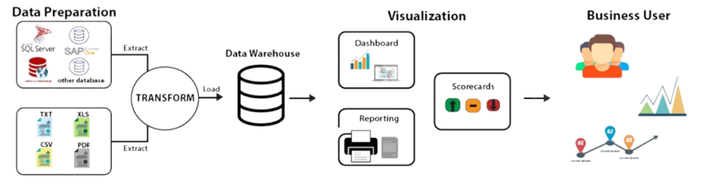
Power BI Architecture

Slide 5
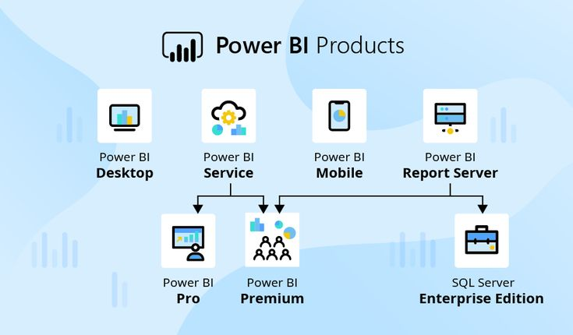

Slide 6
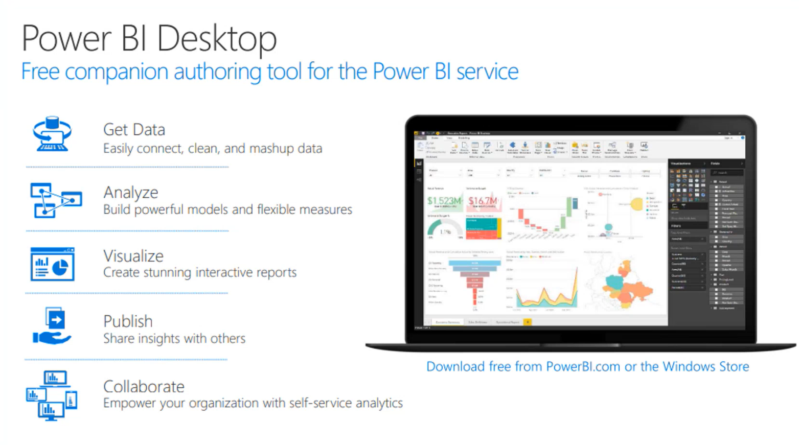

Slide 7
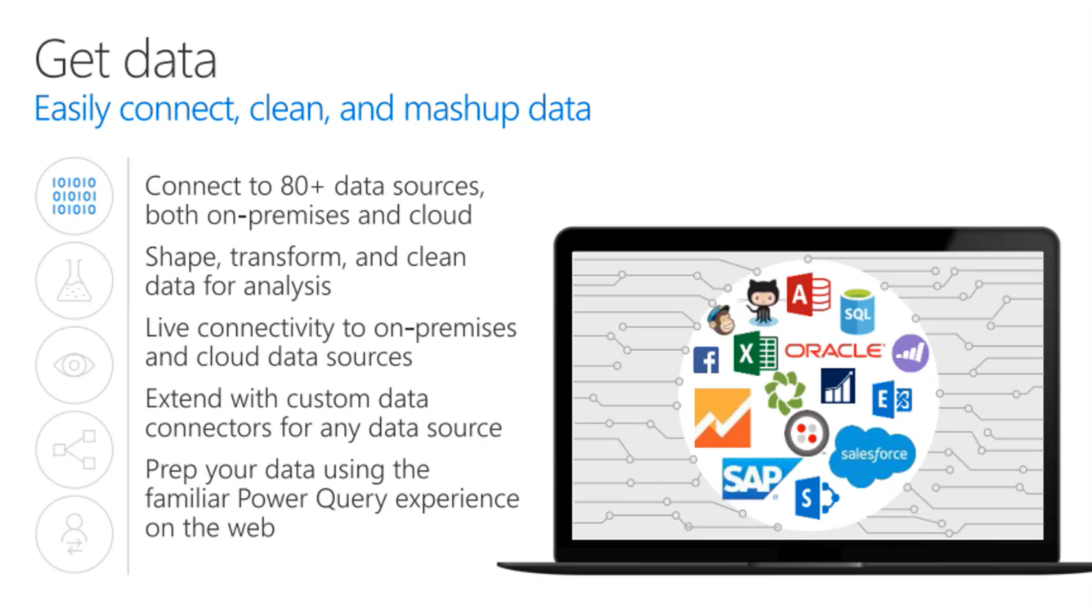

Slide 8
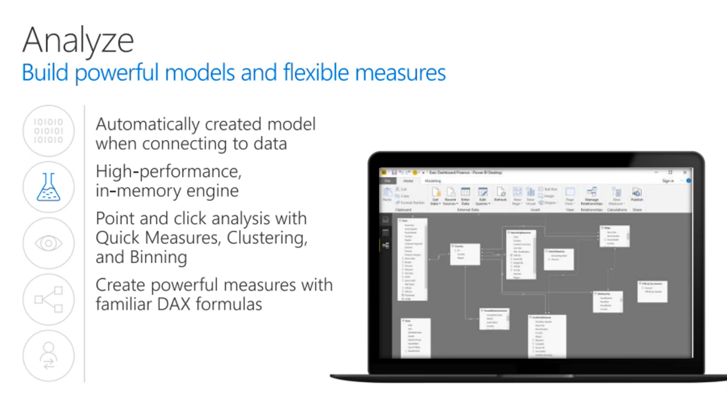

Slide 9
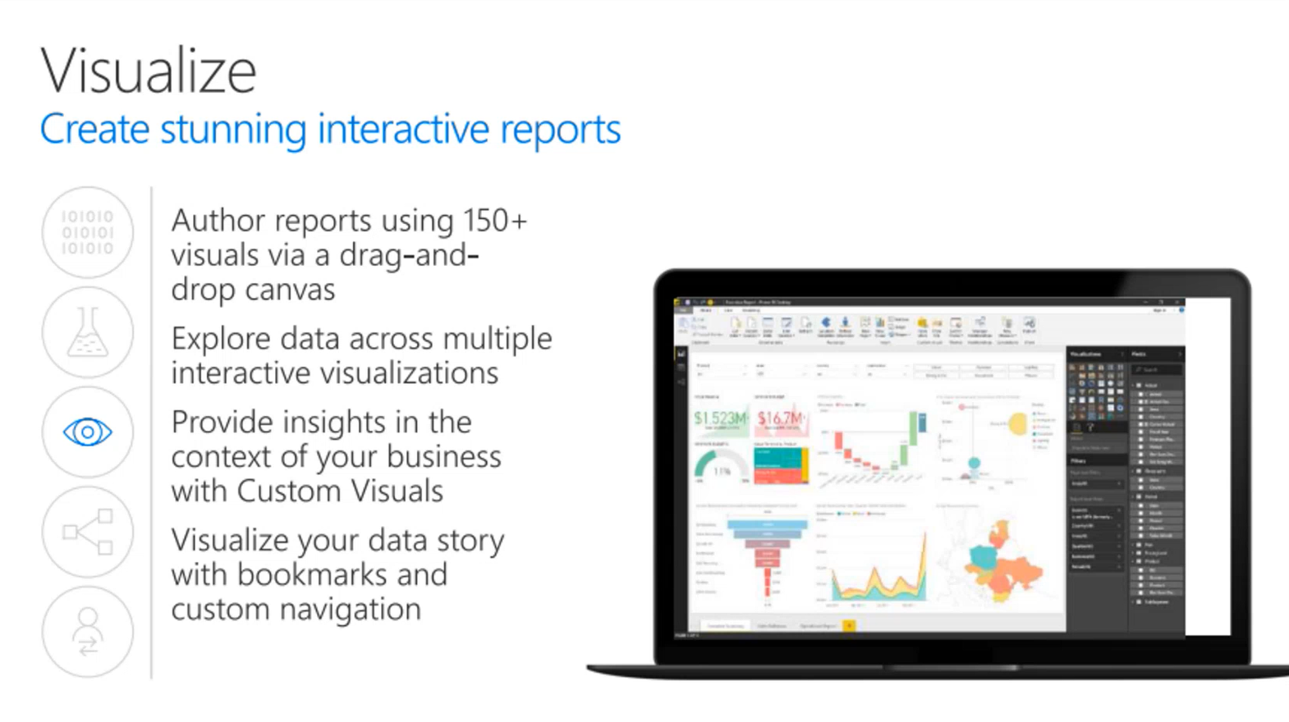

Slide 10
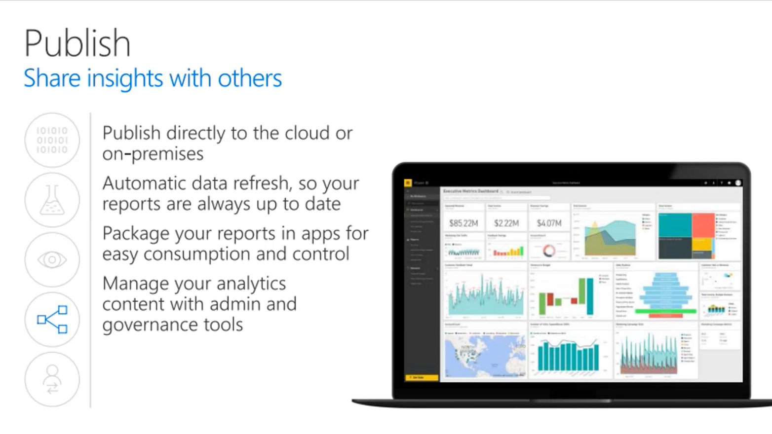

Slide 11
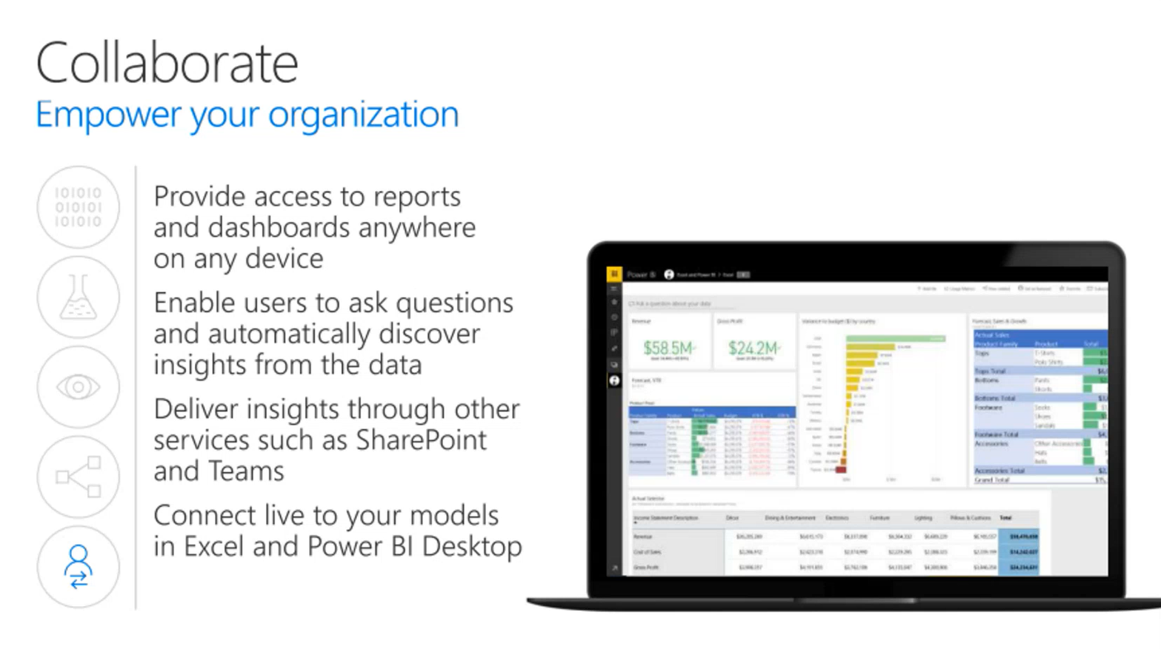

Slide 12
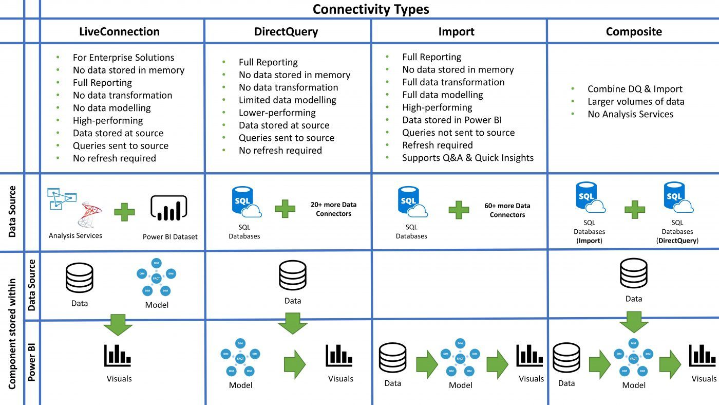

Slide 13
Understanding Star Schemas for Power BI Success
Unlocking Data Insights with Optimal Design

Slide 14
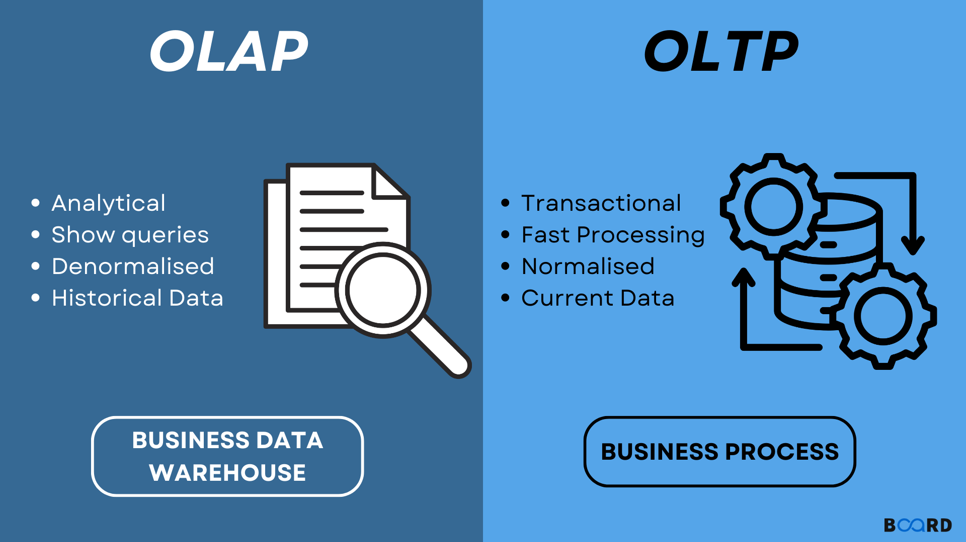

Slide 15
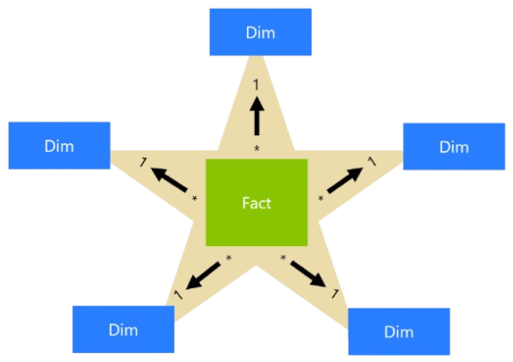
What is a Star Schema?
A star schema is a data modeling technique used in data warehouses and business intelligence.
It consists of a central fact table (containing numerical data, metrics) and multiple dimension tables (providing context to those metrics).
Examples:
                - Fact Table: Sales transactions (quantity, revenue)
      - Dimension Tables: Product, Customer, Date, Store

Slide 16
What is a Star Schema?
Normalization vs. Denormalization: While a star schema denormalizes data to optimize query performance, the trade-off is potentially higher storage requirements compared to highly normalized schemas.
It is important to balance business reporting needs with storage and performance considerations when designing a star schema.
Dimensional Modeling: The key to a successful star schema lies in dimensional modeling, where business dimensions like time, product, and location play a central role in analysis.

Slide 17
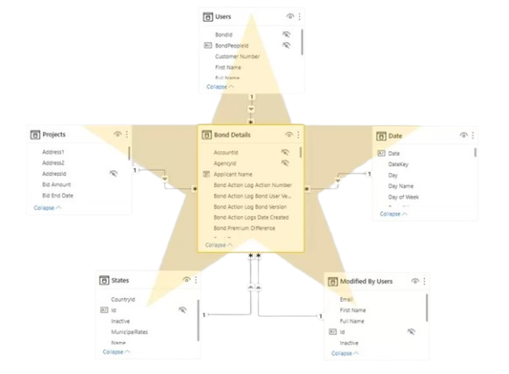
Why Star Schemas Matter for Power BI
Performance: Optimized for fast query responses in Power BI.
Ease of Use: Intuitive structure makes report creation simple.
Flexibility: Adaptable to changing business requirements.
Scalability: Handles large datasets effectively.

Slide 18
How to Design a Star Schema in Power BI
Identify the Business Process: What questions do you need to answer? (e.g., sales analysis, inventory management)
Define the Fact Table: Choose the key metrics you want to track (e.g., sales amount, units sold).
Create Dimension Tables: Identify the dimensions that provide context to those metrics (e.g., time, product, customer).
Establish Relationships: Use Power BI to connect the fact table to each dimension table.

